Slide 1
Microsoft Visual C#: An Introduction to Object-Oriented Programming
7th Edition
Chapter 6
Using Arrays
© 2018 Cengage. All Rights Reserved. May not be copied, scanned, or duplicated, in whole or in part, except for use as permitted in a license distributed with a certain product or service or otherwise on a password-protected website for classroom use.

Slide 2
Objectives
6.1 Declare an array and assign values to array elements
6.2 Access array elements
6.3 Search an array using a loop
6.4 Use the BinarySearch(), Sort(), and Reverse() methods
6.5 Use multidimensional arrays
6.6 Appreciate array issues in GUI programs
© 2018 Cengage. May not be copied, scanned, or duplicated, in whole or in part, except for use as permitted in a license distributed with a certain product or service or otherwise on a password-protected website for classroom use.

Slide 3
Declaring an Array and Assigning Values (1 of 3)
Array
A list of data items that all have the same data type and the same name
Each object in an array is an array element
You can distinguish each element from the others in an array with a subscript
A subscript is also called an index
Declaring and creating an array
double[] sales;
sales = new double[20];
new operator
Used to create objects
You can change the size of an array
© 2018 Cengage. May not be copied, scanned, or duplicated, in whole or in part, except for use as permitted in a license distributed with a certain product or service or otherwise on a password-protected website for classroom use.

Slide 4
Declaring an Array and Assigning Values (2 of 3)
Array element
Each object in an array
Subscript (or index)
An integer contained within square brackets that indicates the position of one of an array’s elements
An array’s elements are numbered beginning with 0
“Off by one”
Remember to start counting at zero!
Item 1 in an array is Element [0]
Item 2 in an array is Element [1]
© 2018 Cengage. May not be copied, scanned, or duplicated, in whole or in part, except for use as permitted in a license distributed with a certain product or service or otherwise on a password-protected website for classroom use.

Slide 5
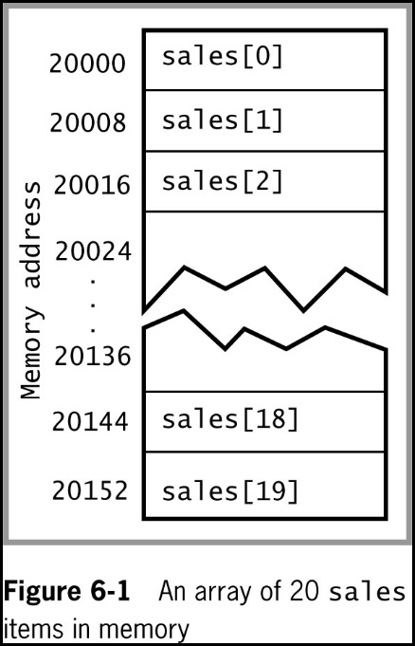
Declaring an Array and Assigning Values (3 of 3)
Assigning a value to an array element
sales[0] = 2100.00;
Printing an element value
WriteLine(sales[19]);
© 2018 Cengage. May not be copied, scanned, or duplicated, in whole or in part, except for use as permitted in a license distributed with a certain product or service or otherwise on a password-protected website for classroom use.

Slide 6
Initializing an Array (1 of 2)
In C#, arrays are objects
Arrays are instances of a class named System.Array
Initializing objects
Numeric fields are set to 0
Character fields are set to ‘\u0000’ or null
bool fields are set to false
Initializer list
A list of values provided for an array
© 2018 Cengage. May not be copied, scanned, or duplicated, in whole or in part, except for use as permitted in a license distributed with a certain product or service or otherwise on a password-protected website for classroom use.

Slide 7
Initializing an Array (2 of 2)
An Initializer list is the list of values provided for an array
Examples (each does the same thing)
int[ ] myScores = new int[5] {100, 76, 88, 100, 90};
int[ ] myScores = new int[ ] {100, 76, 88, 100, 90};
int[ ] myScores = {100, 76, 88, 100, 90};
If you declare a size, then you must list a value for each element (example 1)
If you initialize an array with values, you are not required to give the array a size (example 2)
If you initialize an array, you do not need to use the keyword new (example 3)
© 2018 Cengage. May not be copied, scanned, or duplicated, in whole or in part, except for use as permitted in a license distributed with a certain product or service or otherwise on a password-protected website for classroom use.

Slide 8
Accessing Array Elements
The power of arrays becomes apparent when you use subscripts that are variables rather than constant values
Remember that variables can change values
Using a loop to perform arithmetic on each element
int sub = 0;
while (sub < 5)
{
myScores[sub] += 3;
++sub;
}
or:
For (int sub = 0; sub < 5; ++sub)
myScores[sub] += 3;
© 2018 Cengage. May not be copied, scanned, or duplicated, in whole or in part, except for use as permitted in a license distributed with a certain product or service or otherwise on a password-protected website for classroom use.

Slide 9
Using the Length Property
Length property
A member of the System.Array class
Automatically holds an array’s length
If the subscript, or index, is greater than the last valid index (e.g., the index value is 20 for a 20-element array), you will get a System.IndexOutOfRangeException…the highest valid index value is 19
Examples
int[ ] myScores = {100, 76, 88, 100, 90};
WriteLine ("Array size is {0}",myScores.Length);
for (int x = 0; x < myScores.Length; ++x)
WriteLine (myScores[x]);
© 2018 Cengage. May not be copied, scanned, or duplicated, in whole or in part, except for use as permitted in a license distributed with a certain product or service or otherwise on a password-protected website for classroom use.

Slide 10
Using foreach (1 of 2)
foreach statement
Cycles through every array element without using a subscript
Uses a temporary iteration variable that automatically holds each array value in turn
Examples
double[ ] payRate = {6.00, 7.35, 8.12, 12.45, 22.22};
foreach (double money in payRate)
WriteLine("{0}", money.ToString("C"));
© 2018 Cengage. May not be copied, scanned, or duplicated, in whole or in part, except for use as permitted in a license distributed with a certain product or service or otherwise on a password-protected website for classroom use.

Slide 11
Using foreach (2 of 2)
The foreach statement is used only under certain circumstances:
Use when you want to access every array element
Since the iteration variable is read-only, you can access it but you cannot assign a value to it
© 2018 Cengage. May not be copied, scanned, or duplicated, in whole or in part, except for use as permitted in a license distributed with a certain product or service or otherwise on a password-protected website for classroom use.

Slide 12
Searching an Array Using a Loop
Instead of creating a long series of if statements to search an array
There are a couple other options
Searching options
Using a for loop
Using a while loop
© 2018 Cengage. May not be copied, scanned, or duplicated, in whole or in part, except for use as permitted in a license distributed with a certain product or service or otherwise on a password-protected website for classroom use.

Slide 13
Using a for Loop to Search an Array (1 of 3)
Example of using a for loop to search an array:
for (int x = 0; x < validValues.Length; ++x)
if (itemOrdered == validValues[x])
isValidItem = true;
Called a Sequential Search because each array element is examined in sequence
Parallel arrays (a second array to hold corresponding data) allow you to use the same subscript to access additional information
© 2018 Cengage. May not be copied, scanned, or duplicated, in whole or in part, except for use as permitted in a license distributed with a certain product or service or otherwise on a password-protected website for classroom use.

Slide 14
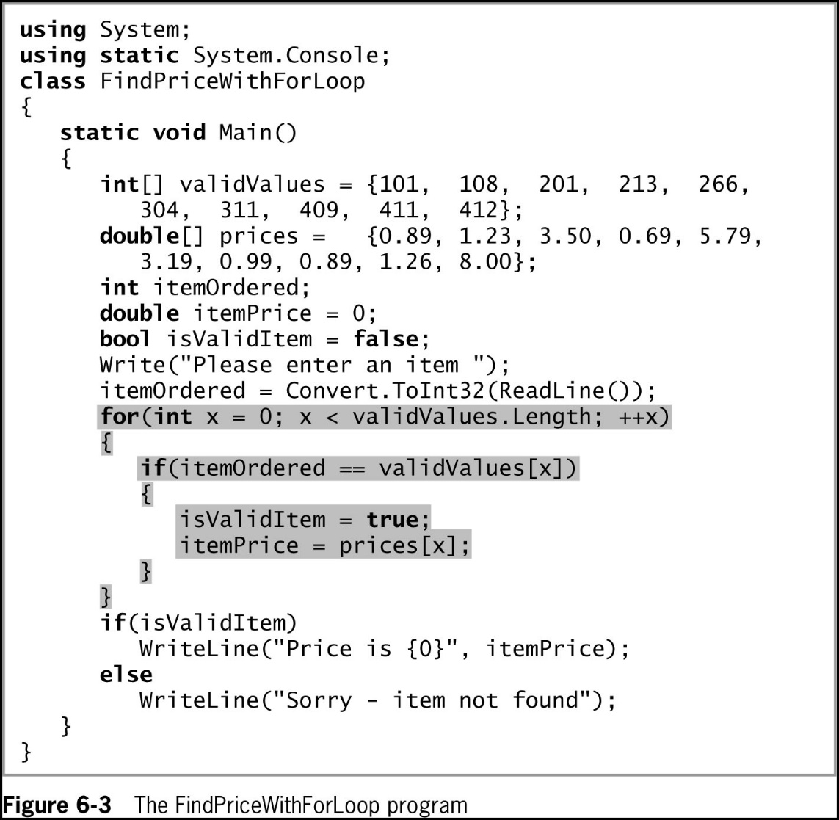
Using a for Loop to Search an Array (2 of 3)
© 2018 Cengage. May not be copied, scanned, or duplicated, in whole or in part, except for use as permitted in a license distributed with a certain product or service or otherwise on a password-protected website for classroom use.

Slide 15
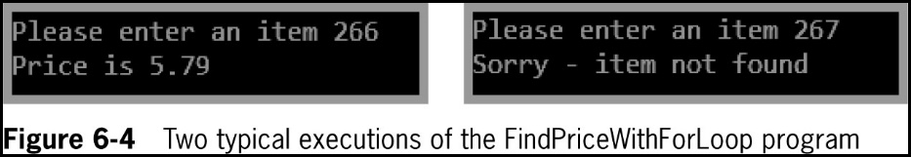
Using a for Loop to Search an Array (3 of 3)
© 2018 Cengage. May not be copied, scanned, or duplicated, in whole or in part, except for use as permitted in a license distributed with a certain product or service or otherwise on a password-protected website for classroom use.

Slide 16
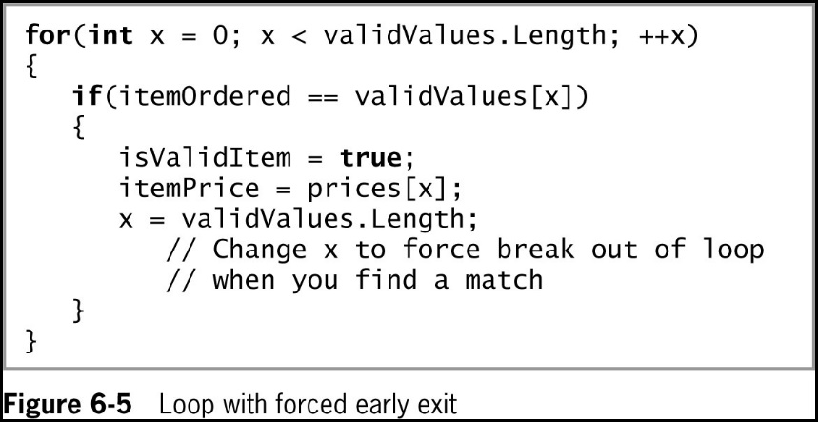
Improving a Loop’s Efficiency (1 of 2)
© 2018 Cengage. May not be copied, scanned, or duplicated, in whole or in part, except for use as permitted in a license distributed with a certain product or service or otherwise on a password-protected website for classroom use.

Slide 17
Improving a Loop’s Efficiency (2 of 2)
In the code segment in Figure 6-5, instead of the statement that sets x to validValues.Length when a match is found
You could remove that statement and change the comparison in the middle section of the for statement to a compound statement:
for (int x = 0; x < validValues.Length && !isValidItem; ++x)
If you decide to leave a loop as soon as a match is found
The most efficient strategy is to place the most common items first so they are matched sooner
Some programmers disapprove of exiting a for loop early
Programs are easier to debug and maintain if each program segment has only one entry and one exit point
Select an approach that uses a while statement
© 2018 Cengage. May not be copied, scanned, or duplicated, in whole or in part, except for use as permitted in a license distributed with a certain product or service or otherwise on a password-protected website for classroom use.

Slide 18
Using a while Loop to Search an Array (1 of 3)
Use a while loop to search for a match
Set a subscript to 0 and, while the item being searched for is not equal to a value in the array, increase the subscript and keep looking
You search only while the subscript remains lower than the number of elements in the array
© 2018 Cengage. May not be copied, scanned, or duplicated, in whole or in part, except for use as permitted in a license distributed with a certain product or service or otherwise on a password-protected website for classroom use.

Slide 19
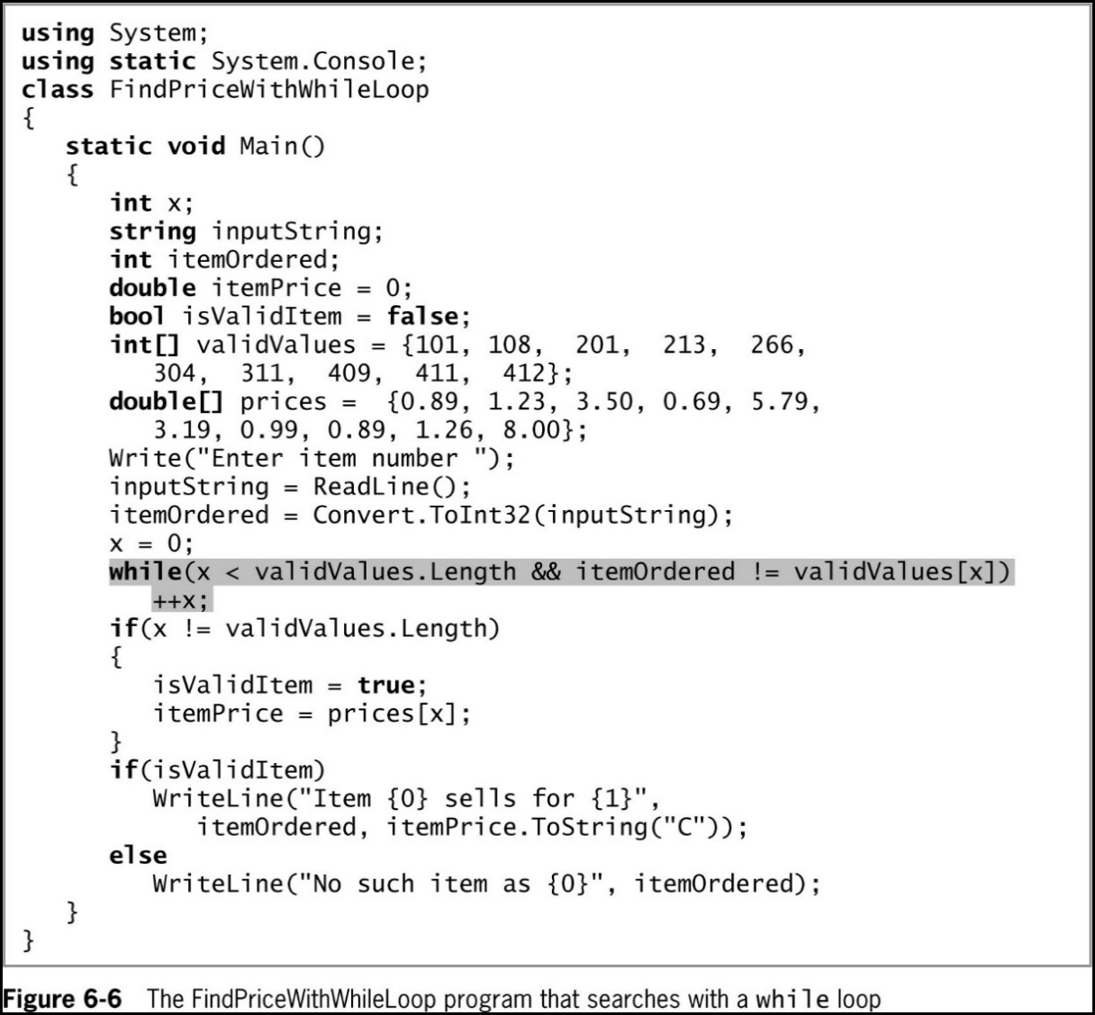
Using a while Loop to Search an Array (2 of 3)
© 2018 Cengage. May not be copied, scanned, or duplicated, in whole or in part, except for use as permitted in a license distributed with a certain product or service or otherwise on a password-protected website for classroom use.

Slide 20
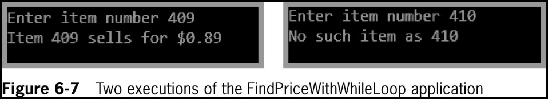
Using a while Loop to Search an Array (3 of 3)
© 2018 Cengage. May not be copied, scanned, or duplicated, in whole or in part, except for use as permitted in a license distributed with a certain product or service or otherwise on a password-protected website for classroom use.

Slide 21
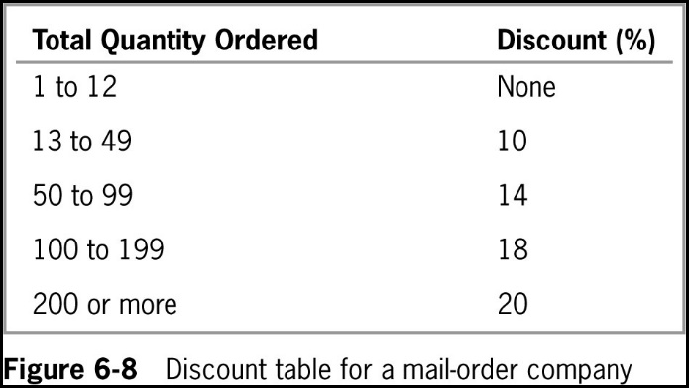
Searching an Array for a Range Match (1 of 2)
Range match
Determines the pair of limiting values between which a value falls
© 2018 Cengage. May not be copied, scanned, or duplicated, in whole or in part, except for use as permitted in a license distributed with a certain product or service or otherwise on a password-protected website for classroom use.

Slide 22
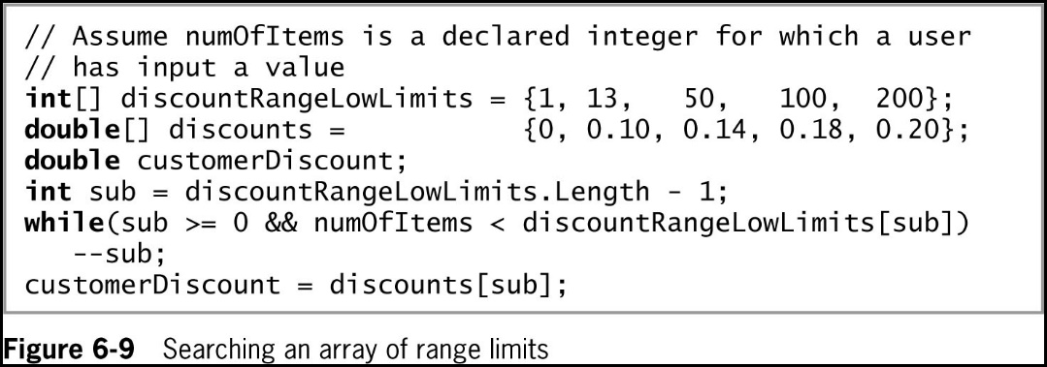
Searching an Array for a Range Match (2 of 2)
© 2018 Cengage. May not be copied, scanned, or duplicated, in whole or in part, except for use as permitted in a license distributed with a certain product or service or otherwise on a password-protected website for classroom use.

Slide 23
Using the BinarySearch(), Sort(), and Reverse() Methods
The System.Array class contains a variety of useful, built-in methods that can search, sort, and manipulate array elements
This section shows you how to use the methods:
Array.BinarySearch() – to find an element in an array
Array.Sort() – to sort an array’s elements
Array.Reverse() – to reverse the order of elements
If you include the statement using static System.Array();
You can use each of these methods without using the Array class name and the dot
© 2018 Cengage. May not be copied, scanned, or duplicated, in whole or in part, except for use as permitted in a license distributed with a certain product or service or otherwise on a password-protected website for classroom use.

Slide 24
Using the BinarySearch() Method (1 of 3)
BinarySearch() method
a sorted list of objects is split in half repeatedly as the search gets closer and closer to a match
Similar to the “guess a Number between 1 and 100” game
Start with Is it less than 50? Less than 25? Less than 12? Etc.
When not to use BinarySearch()
If your array items are not arranged in ascending order
If your array holds duplicate values and you want to find all of them
If you want to find a range match rather than an exact match
© 2018 Cengage. May not be copied, scanned, or duplicated, in whole or in part, except for use as permitted in a license distributed with a certain product or service or otherwise on a password-protected website for classroom use.

Slide 25
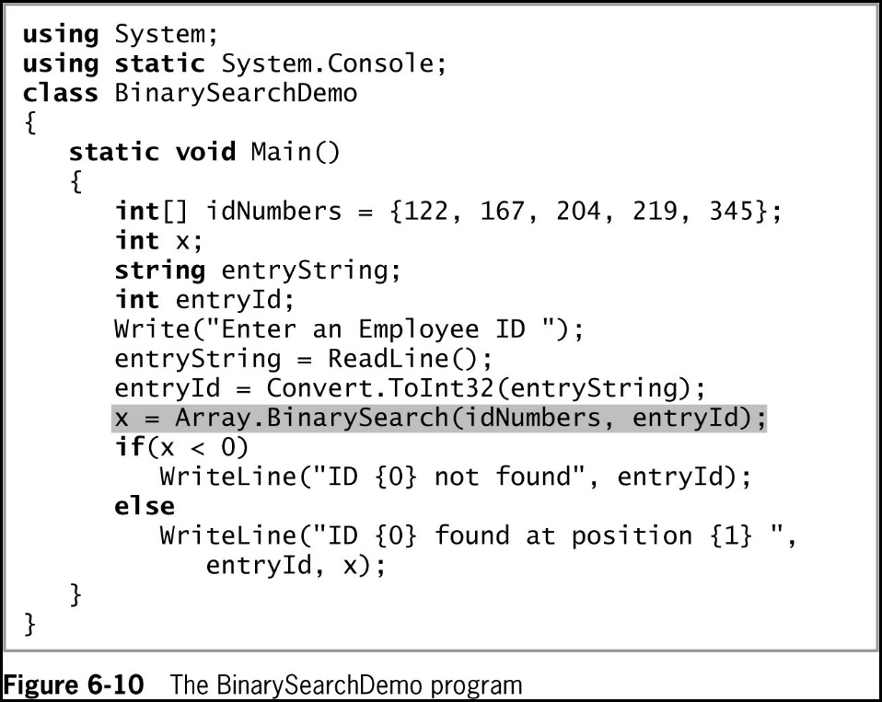
Using the BinarySearch() Method (2 of 3)
© 2018 Cengage. May not be copied, scanned, or duplicated, in whole or in part, except for use as permitted in a license distributed with a certain product or service or otherwise on a password-protected website for classroom use.

Slide 26
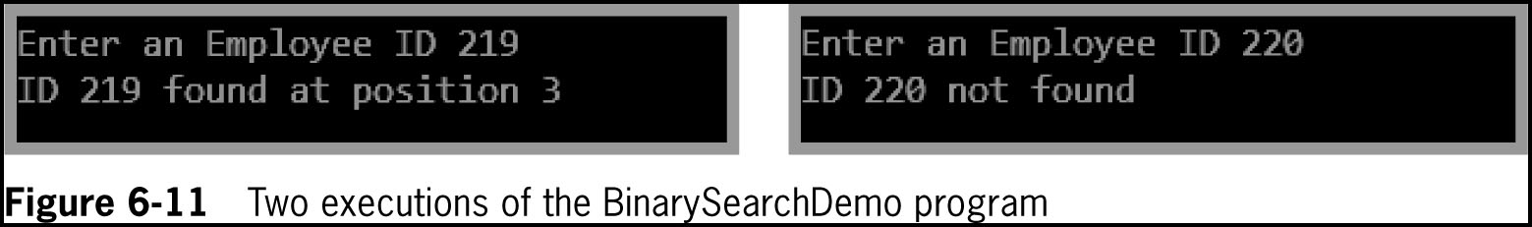
Using the BinarySearch() Method (3 of 3)
© 2018 Cengage. May not be copied, scanned, or duplicated, in whole or in part, except for use as permitted in a license distributed with a certain product or service or otherwise on a password-protected website for classroom use.

Slide 27
Using the Sort() Method (1 of 3)
Sort() method
Arranges array items in ascending order
Works numerically for number types and alphabetically for characters and strings
Use it by passing the array name to Array.Sort()
Often used before using the BinarySearch() method which requires a sorted array
© 2018 Cengage. May not be copied, scanned, or duplicated, in whole or in part, except for use as permitted in a license distributed with a certain product or service or otherwise on a password-protected website for classroom use.

Slide 28
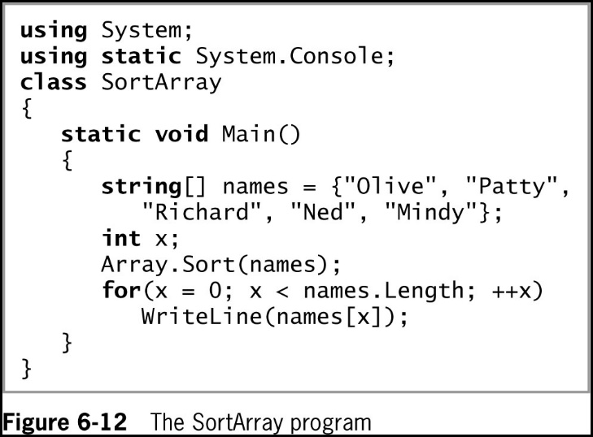
Using the Sort() Method (2 of 3)
© 2018 Cengage. May not be copied, scanned, or duplicated, in whole or in part, except for use as permitted in a license distributed with a certain product or service or otherwise on a password-protected website for classroom use.

Slide 29
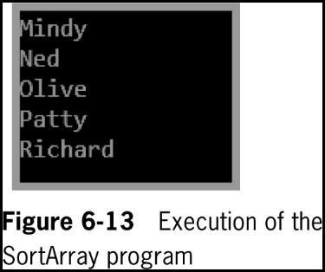
Using the Sort() Method (3 of 3)
© 2018 Cengage. May not be copied, scanned, or duplicated, in whole or in part, except for use as permitted in a license distributed with a certain product or service or otherwise on a password-protected website for classroom use.

Slide 30
Using the Reverse() Method (1 of 3)
Reverse() method
The Reverse() method does not sort array elements; it only rearranges their values to the opposite order
An element that starts in position 0 is relocated to position Length – 1 and an element that starts in position 1 is relocated to position Length – 2
Use it by passing the array name to the method
© 2018 Cengage. May not be copied, scanned, or duplicated, in whole or in part, except for use as permitted in a license distributed with a certain product or service or otherwise on a password-protected website for classroom use.

Slide 31
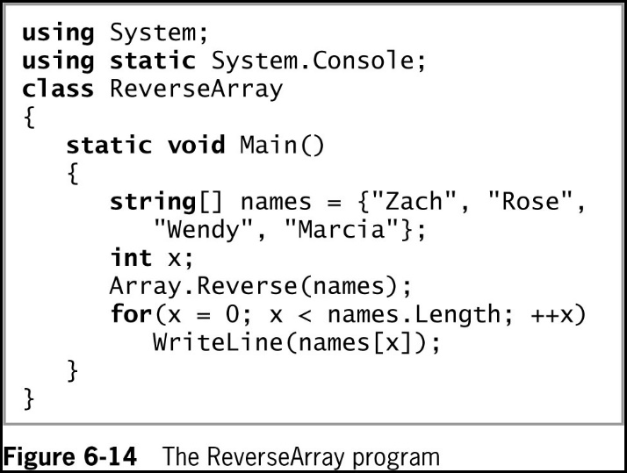
Using the Reverse() Method (2 of 3)
© 2018 Cengage. May not be copied, scanned, or duplicated, in whole or in part, except for use as permitted in a license distributed with a certain product or service or otherwise on a password-protected website for classroom use.

Slide 32
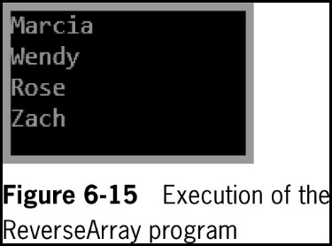
Using the Reverse() Method (3 of 3)
© 2018 Cengage. May not be copied, scanned, or duplicated, in whole or in part, except for use as permitted in a license distributed with a certain product or service or otherwise on a password-protected website for classroom use.

Slide 33
Using Multidimensional Arrays (1 of 7)
One-dimensional or single-dimensional array
Picture it as a column of values
Elements can be accessed using a single subscript
Multidimensional array
Requires multiple subscripts to access the array elements
Two-dimensional array
Has two or more columns of values for each row
Rectangular array (also called a matrix, or a table)
Each row has the same number of columns
Similar to a spreadsheet
© 2018 Cengage. May not be copied, scanned, or duplicated, in whole or in part, except for use as permitted in a license distributed with a certain product or service or otherwise on a password-protected website for classroom use.

Slide 34
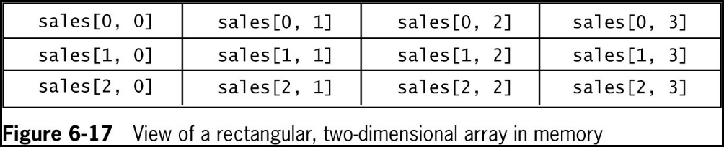
Using Multidimensional Arrays (2 of 7)
© 2018 Cengage. May not be copied, scanned, or duplicated, in whole or in part, except for use as permitted in a license distributed with a certain product or service or otherwise on a password-protected website for classroom use.

Slide 35
Using Multidimensional Arrays (3 of 7)
Initializing the array:
double[ , ] sales = {{14.00, 15.00, 16.00, 17.00},
{21.99, 34.55, 67.88, 31.99},
{12.03, 55.55, 32.89, 1.17}};
The sales array contains three rows and four columns
When you refer to an element in a two-dimensional array
The first value within the brackets following the array name always refers to the row
The second value, after the comma, refers to the column
© 2018 Cengage. May not be copied, scanned, or duplicated, in whole or in part, except for use as permitted in a license distributed with a certain product or service or otherwise on a password-protected website for classroom use.

Slide 36
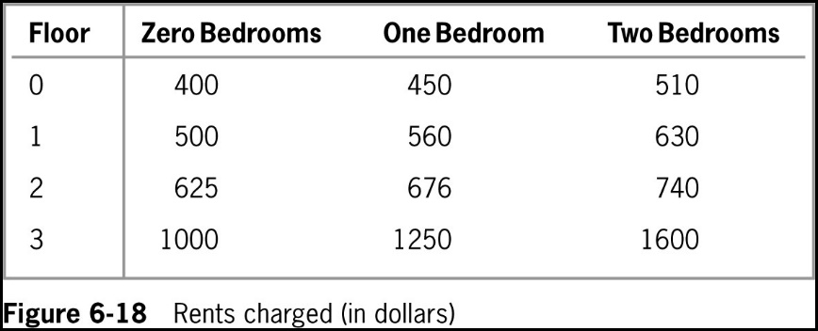
Using Multidimensional Arrays (4 of 7)
The following code is shown in Figure 6-18:
int[ , ] rents = { {400, 450, 510},
{500, 560, 630},
{625, 676, 740},
{1000, 1250, 1600} };
© 2018 Cengage. May not be copied, scanned, or duplicated, in whole or in part, except for use as permitted in a license distributed with a certain product or service or otherwise on a password-protected website for classroom use.

Slide 37
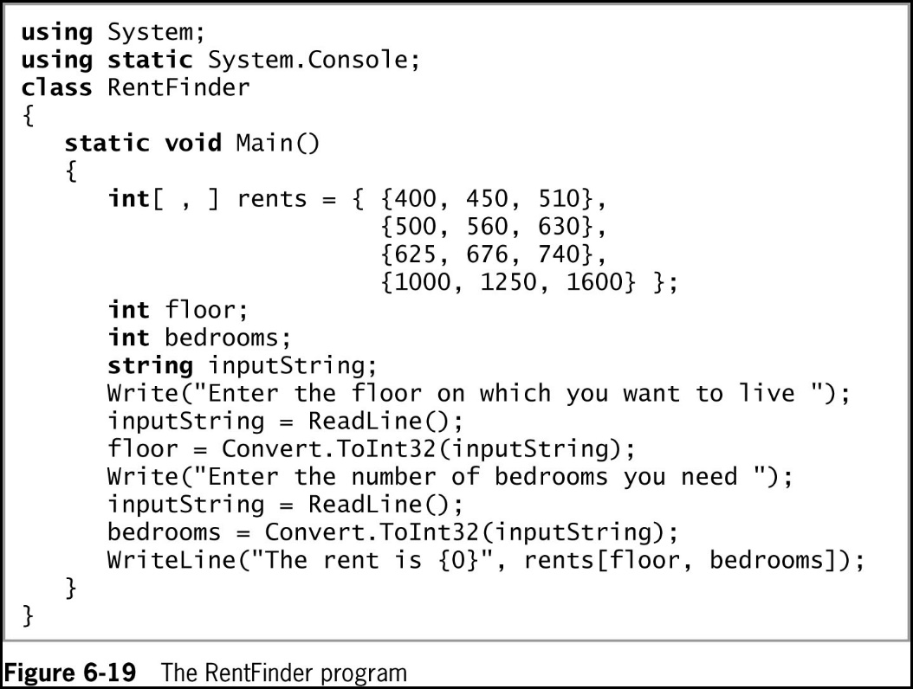
Using Multidimensional Arrays (5 of 7)
© 2018 Cengage. May not be copied, scanned, or duplicated, in whole or in part, except for use as permitted in a license distributed with a certain product or service or otherwise on a password-protected website for classroom use.

Slide 38
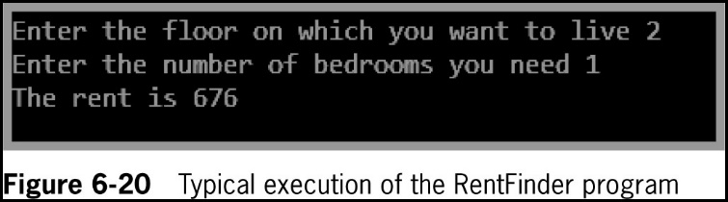
Using Multidimensional Arrays (6 of 7)
© 2018 Cengage. May not be copied, scanned, or duplicated, in whole or in part, except for use as permitted in a license distributed with a certain product or service or otherwise on a password-protected website for classroom use.

Slide 39
Using Multidimensional Arrays (7 of 7)
Figure 6-21 shows a three-dimensional array definition
A set of curly braces surrounds all the data; the inner curly braces represent the following:
Four inner sets of braces surround the data for each building – each row of values represents a building (0 through 3)
Within each row, the three sets of inner braces represent each floor
Within each floor, the two braced values represent the bedrooms
The value of rents[3,1,0] is $1050 in Figure 6-21
© 2018 Cengage. May not be copied, scanned, or duplicated, in whole or in part, except for use as permitted in a license distributed with a certain product or service or otherwise on a password-protected website for classroom use.

Slide 40
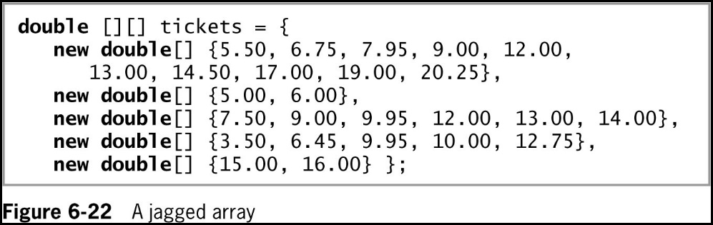
Using Jagged Arrays
Jagged array
A one-dimensional array in which each element is another one-dimensional array
Each row can be a different length
© 2018 Cengage. May not be copied, scanned, or duplicated, in whole or in part, except for use as permitted in a license distributed with a certain product or service or otherwise on a password-protected website for classroom use.

Slide 41
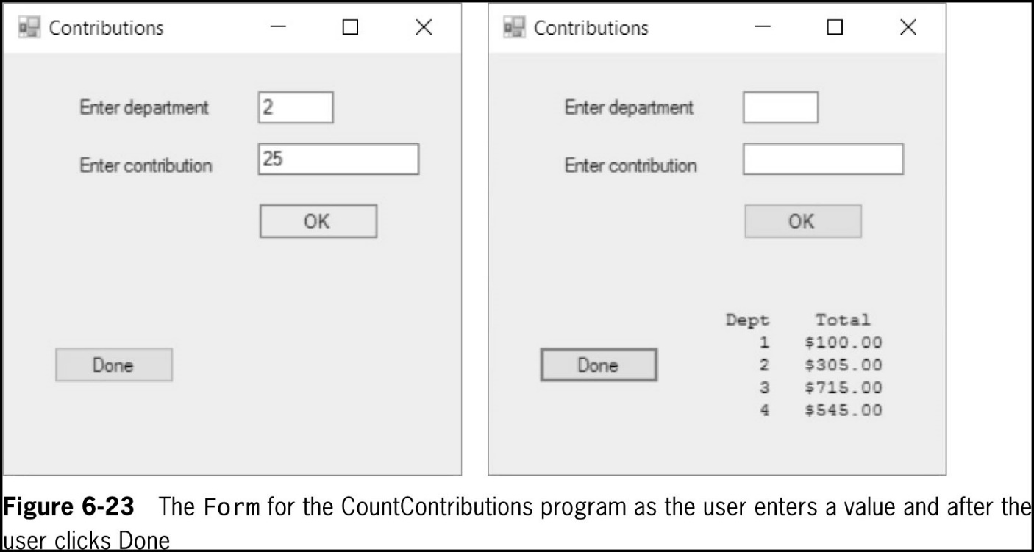
Array Issues in GUI Programs (1 of 2)
If array values change based on user input, the array must be stored outside any method that reacts to the user’s event
© 2018 Cengage. May not be copied, scanned, or duplicated, in whole or in part, except for use as permitted in a license distributed with a certain product or service or otherwise on a password-protected website for classroom use.

Slide 42
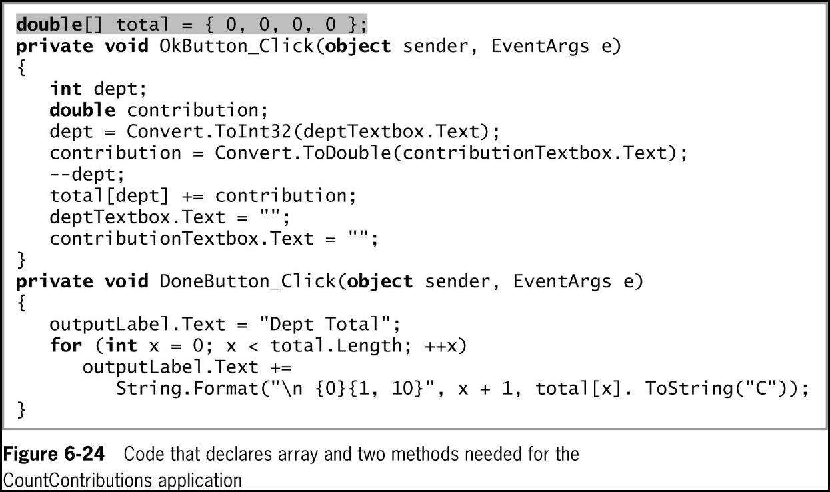
Array Issues in GUI Programs (2 of 2)
© 2018 Cengage. May not be copied, scanned, or duplicated, in whole or in part, except for use as permitted in a license distributed with a certain product or service or otherwise on a password-protected website for classroom use.

Slide 43
Chapter Summary (1 of 3)
An array is a list of data items
All data items have the same type and the same name
Items are distinguished using a subscript or an index
In C#, arrays are objects of a class named System.Array
Arrays are most powerful when variable subscripts are used to process array elements
The subscript you use remains in the range of 0 through Length −1
The foreach statement cycles through every array element without using subscripts
© 2018 Cengage. May not be copied, scanned, or duplicated, in whole or in part, except for use as permitted in a license distributed with a certain product or service or otherwise on a password-protected website for classroom use.

Slide 44
Chapter Summary (2 of 3)
You can compare a variable to a list of values in an array
You can create parallel arrays to more easily perform a range match
The BinarySearch() method finds a requested value in a sorted array
The Sort() method arranges array items in ascending order
The Reverse() method reverses the order of items in an array
© 2018 Cengage. May not be copied, scanned, or duplicated, in whole or in part, except for use as permitted in a license distributed with a certain product or service or otherwise on a password-protected website for classroom use.

Slide 45
Chapter Summary (3 of 3)
Multidimensional arrays require multiple subscripts to access the array elements
Types of multidimensional arrays:
Two-dimensional arrays (rectangular arrays)
Jagged arrays
The major unusual consideration when using an array in a GUI program is that if the array values change based on user input, the array must be stored outside any method that reacts to the user’s event
© 2018 Cengage. May not be copied, scanned, or duplicated, in whole or in part, except for use as permitted in a license distributed with a certain product or service or otherwise on a password-protected website for classroom use.

